Slide 1
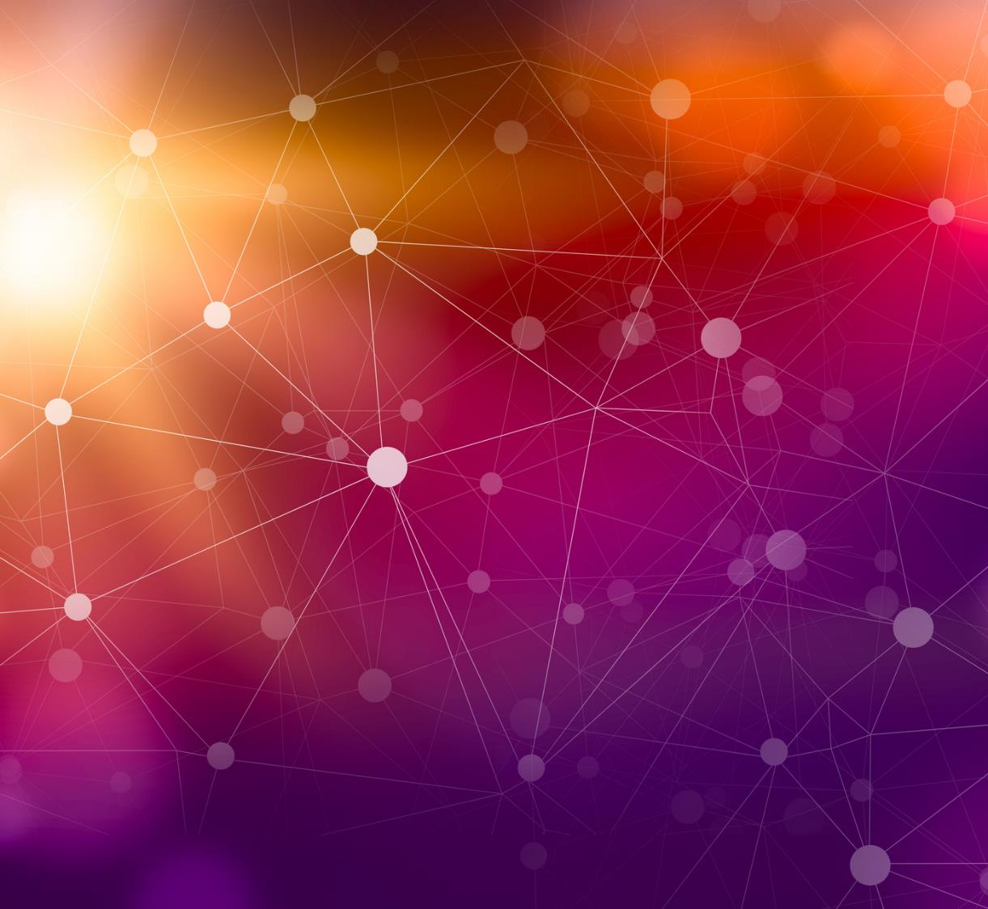
Empowering the Visually Impaired with Handwritten Digit Recognition
Sparsh Rawal
Information Tech Consultants

Slide 2
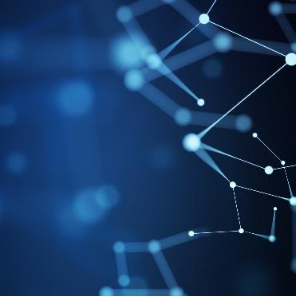
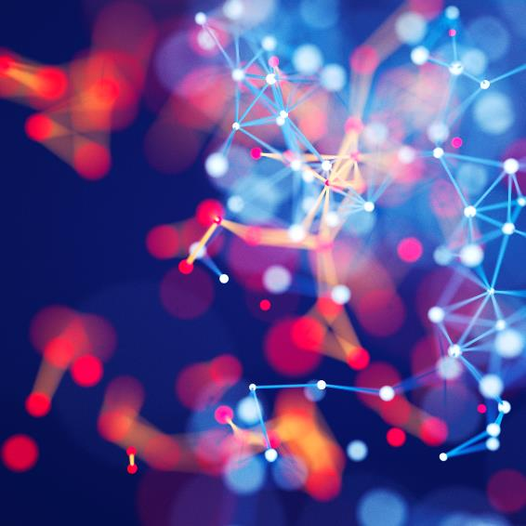
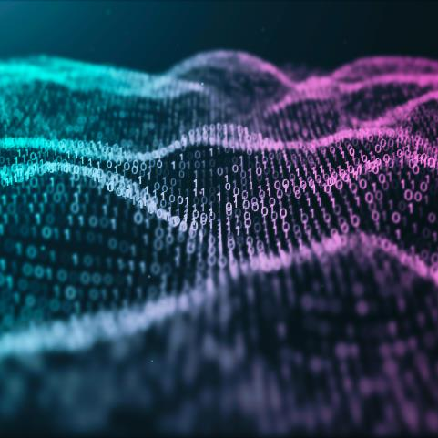
Agenda
Introduction
The Client
The App
The Dataset
Available Models
Key Performance Indicators
Feasibility & Future scope

Slide 3
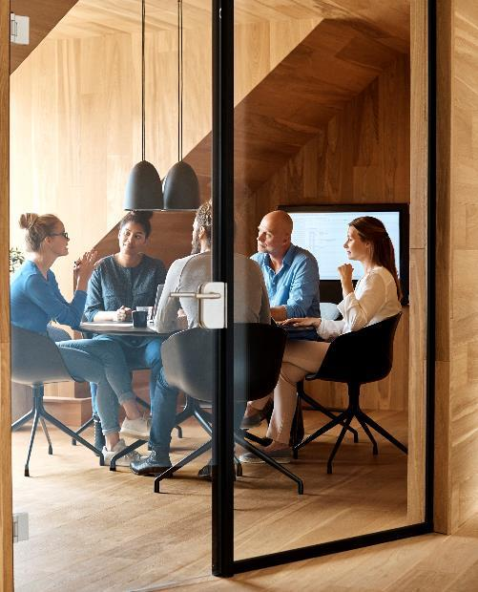
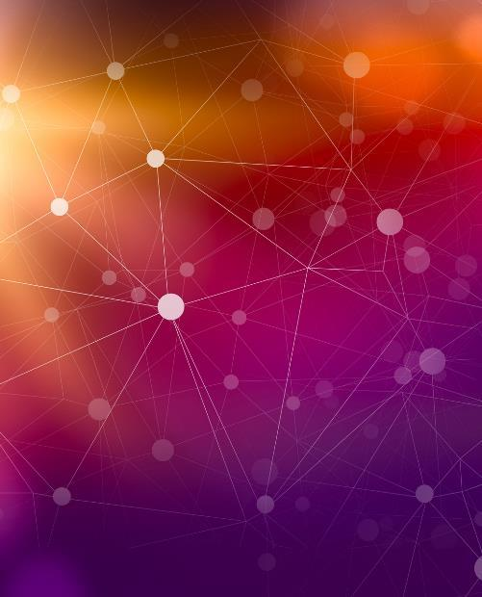

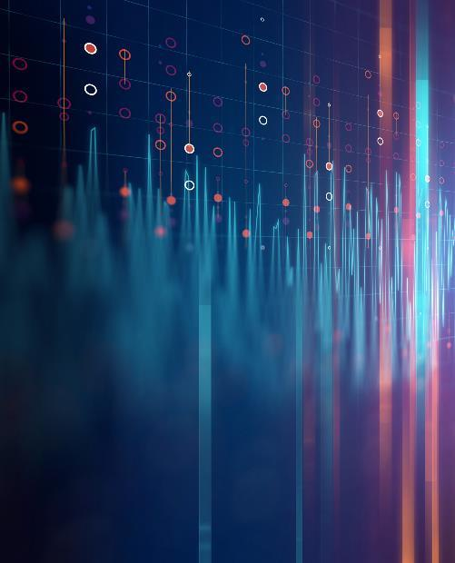
Introduction
This presentation will demonstrate an application which can have a meaningful impact on the lives of such people helping them becoming more independent and making information even more accessible.

Slide 4
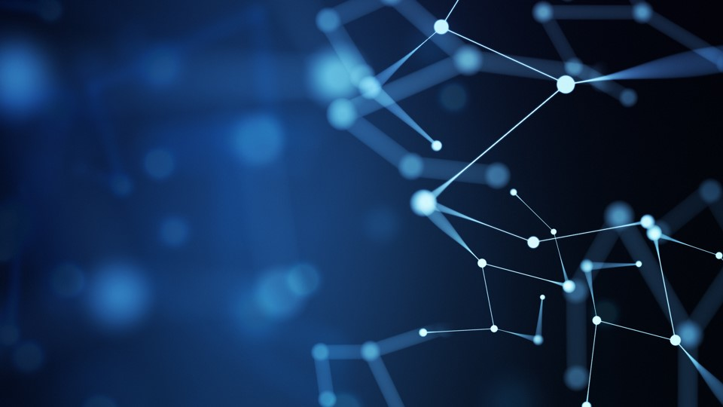
Royal National Institute of Blind People (RNIB)
The Client

Slide 5
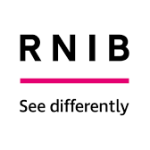
Royal National Institution of Blind People
RNIB is committed to helping blind and partially sighted people.
RNIB offer a range of guides on how to make technology more accessible for blind and partially sighted people. Additionally, they provide financial support to visually impaired people.
They also have an RNIB basic guide for selecting the best suited wearable technology such as smart glasses and head-mounted cameras for blind and partially sighted people.

Slide 6
Speech Tool for Visually Impaired
The App

Slide 7
Challenges & Motivation
People with visual Impairments tend to struggle with everyday tasks which sighted people may often take for granted. The capacity to independently evaluate and comprehend handwritten text is one such challenge.
They tend to rely on sighted assistance for recognizing handwritten numerical characters on forms, labels or even handwritten notes. Finding sighted assistance often proves to be inconvenient or expensive to the individual.
Additionally, certain tasks could be sensitive, particularly those that involve personal and/or sensitive information. Relying on sighted aid could put the person's privacy at risk.

Slide 8

Solution
Through harnessing the power of machine learning models trained on extensive and reliable dataset of handwritten digits, we aim to build a product which enables users to independently interpret and comprehend numerical information without reliance on sighted assistance.
The introduction of Handwritten Digit Recognition is a revolutionary development in the field of accessibility and independence for those with visual impairments.
This cutting-edge model interprets and recognizes handwritten numbers using simple, but effective machine learning algorithms, such as Naïve Bayes, Gaussian Bayes and K-Nearest Neighbors, and delivers real-time feedback via audible means.

Slide 9
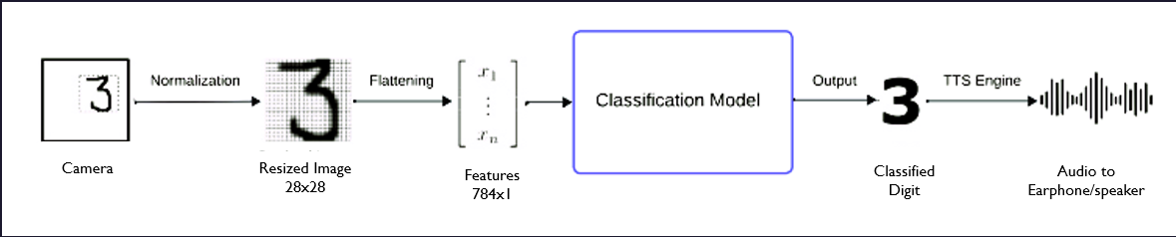
Working
From camera
Firstly, an image of the hand-written digits will be taken from the device.
These images will then be normalized and scaled into 28x28 pixels; this is essential to maintain consistency with the dimensions of the training data used to train our classification models.
The images are then flattened and fed to our classification model, when then works its magic and classifies it into the respective digits.
The classified digits can then be fed to a readily available Text-To-Speech (TTS) Engine which generates an audio for the digits.
The generated audio can be Outputted into Headphones or Speaker.

Slide 10
MNIST Handwritten Dataset
The Dataset

Slide 11
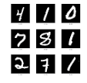
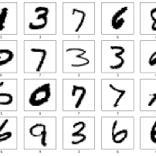
Key features of the MNIST Dataset
The MNIST dataset, is a popular benchmark dataset in the field of machine learning, it consists of grayscale images of handwritten digits.
MNIST is a dataset with ten classes, corresponding to the digits 0 through 9. Each digit class has a set of images associated with it.
In our case, we used the CSV version of the dataset which contains 784 columns corresponding to the pixel values (ranging from 0-255) for each class.
The original MNIST dataset contains 60,000 training images and 10,000 testing images. Each digit class has an approximately equal number of samples in both sets.

Slide 12
Making it ready for training
Although the dataset itself is in numerical format and can directly be used to train our model, it is advisable to perform some normalization on it to ensure that all the features are at the same scale.
The dataset was normalized using min-max technique to ensure that the feature values always lie between 0 and 1.
This is beneficial for the model training as all the pixel values range within 0-1 rather than a larger range of 0-255, and results in better computational efficiency.
This Processed Data was used for the training of various Machine classification model architectures, also for their evaluation.

Slide 13
Classification Architecture
Available Models

Slide 14
Types of Classification models
Naïve Bayes
Gaussian BAYES
KNN Classifier
Naive Bayes operates under the assumption that features are conditionally independent given the class label.
In the context of handwritten digits, this means assuming that the intensity or presence of a pixel is independent of the intensity or presence of other pixels, given the digit class.
Gaussian Bayes assumes that, for each digit class (0-9), the pixel intensities follow a Gaussian distribution.
This means that, given a specific digit class, the distribution of pixel intensities across all pixels is modeled as a bell-shaped curve
KNN Classifier is not explicitly trained, instead it memorizes the entire training dataset.
The KNN classifier identifies the k-nearest neighbors with the smallest distances to the new data point.
It conducts a majority vote among these neighbors, selecting the digit that appears most frequently as the predicted digit for the new data point.

Slide 15
Performance Indicators
Key Performance Indicators

Slide 16
Performance Indicators
Accuracy
Speed of recognition
ADDITIONAL
Accuracy is defined as the ratio of number of correctly predicted classes to the total number of predictions. This is the most ideal metric in the case of a balanced training dataset.
The MNIST Dataset contains evenly distributed datapoints. Hence, Accuracy is a good indicator of the performance of the model.
We set a minimum threshold of 90% accuracy for the models on the test set to be eligible for use in our case.
The speed of recognition mainly depends upon the speed of classification by the model.
The speed of recognition affects the ability of the system to work in real time.
The end-to-end speed of recognition, i.e., the time taken from image capture to audio will also be a key indicator.
The UI of the application should be accessible for the visually challenged people, so that they can easily navigate and use the app.
The developed application should be compatible across a range of mobile devices.
The model should be able to generalize well on varying types of writing styles, i.e., it should be robust

Slide 17
Our Selected Model
We select the KNN classifier for our handwritten digit classification as it has the highest accuracy on the test set i.e. 97.17%.
Running inference on the KNN classifier was relatively slow since it involves calculating the distance between the test point and all the training point on the entire dataset.
However, inference is just a step to measure the model performance and in the real world, the model would never have to classify more than 10-20 digits at a time.
The time taken to predict the class for a single datapoint is around 0.2-0.3 seconds.

Slide 18
Feasibility and Future scope
Feasibility

Slide 19
Feasibility
KNN is a simple Model and effective algorithm which is 97.17% accurate at classifying handwritten digits.
As an added benefit, since the model has high accuracy in recognizing handwritten digits, it will be very accurate in recognizing printed digits.
We plan to integrate our digit classification system in a mobile application, which will recognize handwritten digits based on the images captured by the phone and give an audio feedback to the visually impaired people.
This app can directly be launched by RNIB as a first attempt to make handwritten information more accessible to the individuals.

Slide 20
Future Scope
This application can be further enhanced to recognize handwritten text, rather than just digits, hence it can also be used as a virtual reader.
Furthermore, the application can be seamlessly integrated with an advanced object recognition system, such as YOLO (You Only Look Once).
This integration not only enhances the application's capabilities but also pioneers the creation of an artificial set of eyes for individuals with visual impairments.
The synergy between the handwritten digit recognition and YOLO's robust object detection opens new possibilities for a comprehensive and empowering tool tailored to the unique needs of visually impaired users.

Slide 21

Summary
Unlocked the potential of handwritten digit recognition with the simplicity and effectiveness of the K-Nearest Neighbors (KNN) classifier. A technology that can go beyond pixels, reaching into the realm of empowerment and accessibility and provide a bridge between the tangible strokes of a pen and the digital landscape, creating a seamless connection for all, especially those with visual challenges.

Slide 22
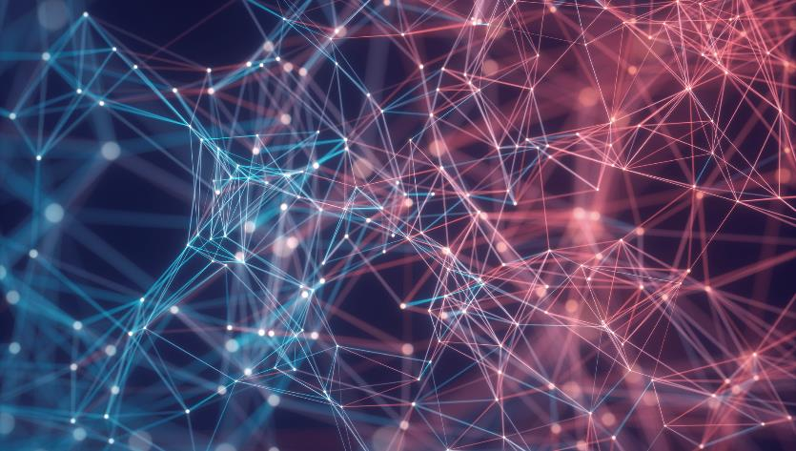
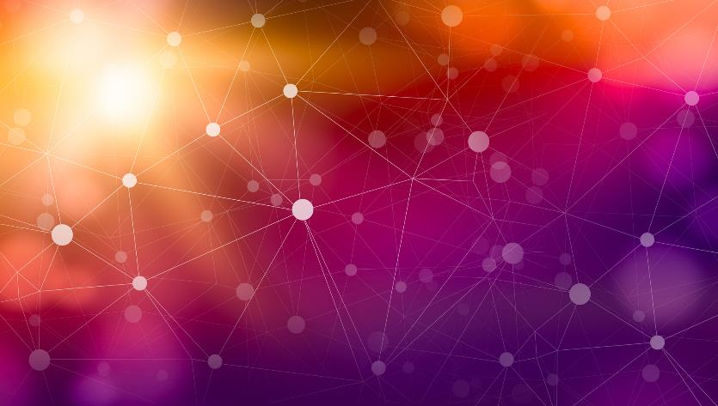
Thank You
Sparsh Rawal

